Slide 1
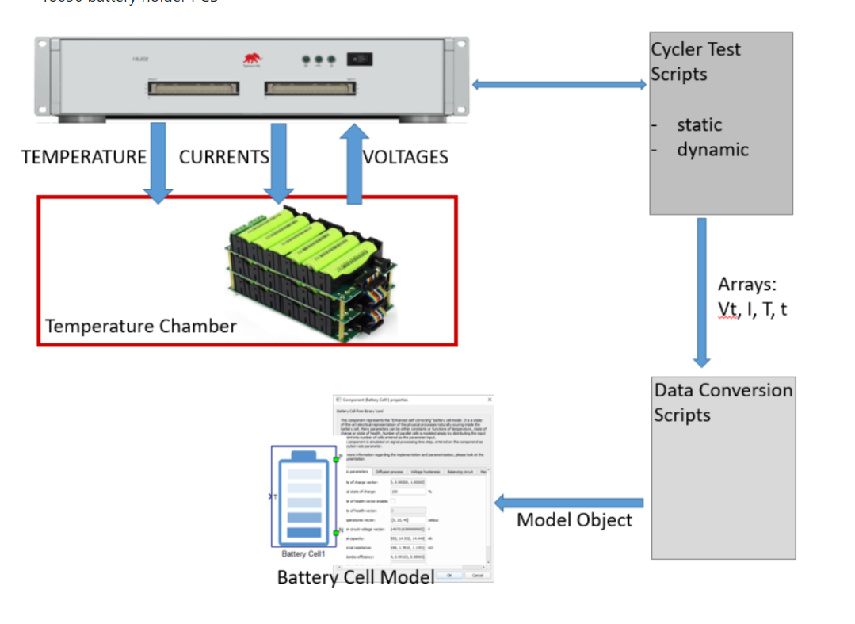
Battery Cell parameter parsing
Project results review
Presentation made in 11.12.2022.
Project originally began in 10.2021.

Slide 2
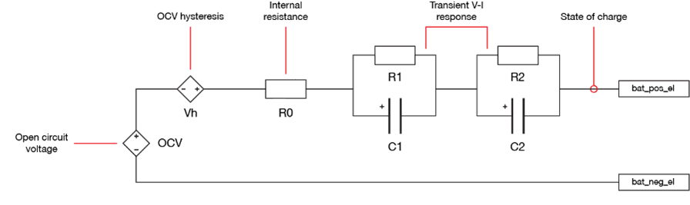
Key results: To estimate cell parameters based on the predefined scripts
Research origins for this project is publicly available on Colorado Boulder University website
Battery cell equivalent electrical circuit

Slide 3
STEPS:
Create Typhoon model containing cell and charger models that will supply the scripts with the appropriate data
Real tests last for days; model simulation speed up (down to 5 minutes of simulationfor complete data)
Static script that estimates: Open Circuit Voltage, capacity and coulombic efficiency as functions of temperature
Dynamic script; estimates internal resistance, diffusion R and C parameters and hysteresis parameters (G, M, M0) also as functions of temperature
Iteratively modify model and scripts, including optimization algorithms to get smaller total RMS error for dynamic range of data
Schematic model should support PHIL setup (1h)
Setup the hardware (batteries, interface PCB with current sources and voltage sensors, temperature chamber)
Iteratively modify model and scripts, including optimization algorithms to get smaller total RMS error for dynamic range of data

Slide 4
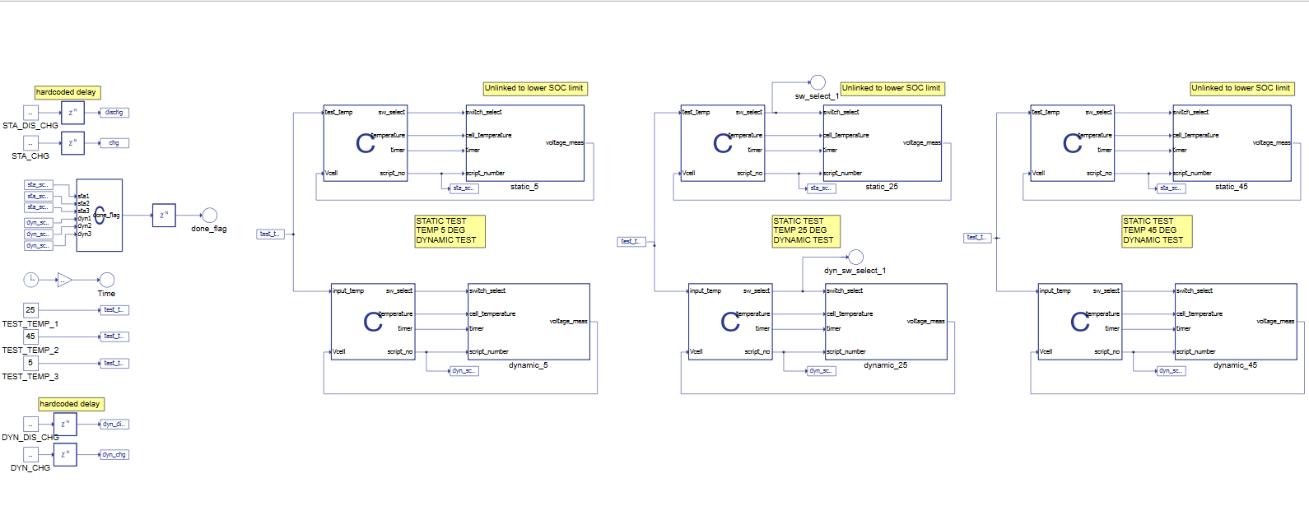
Model for VHIL and PHIL:

Slide 5
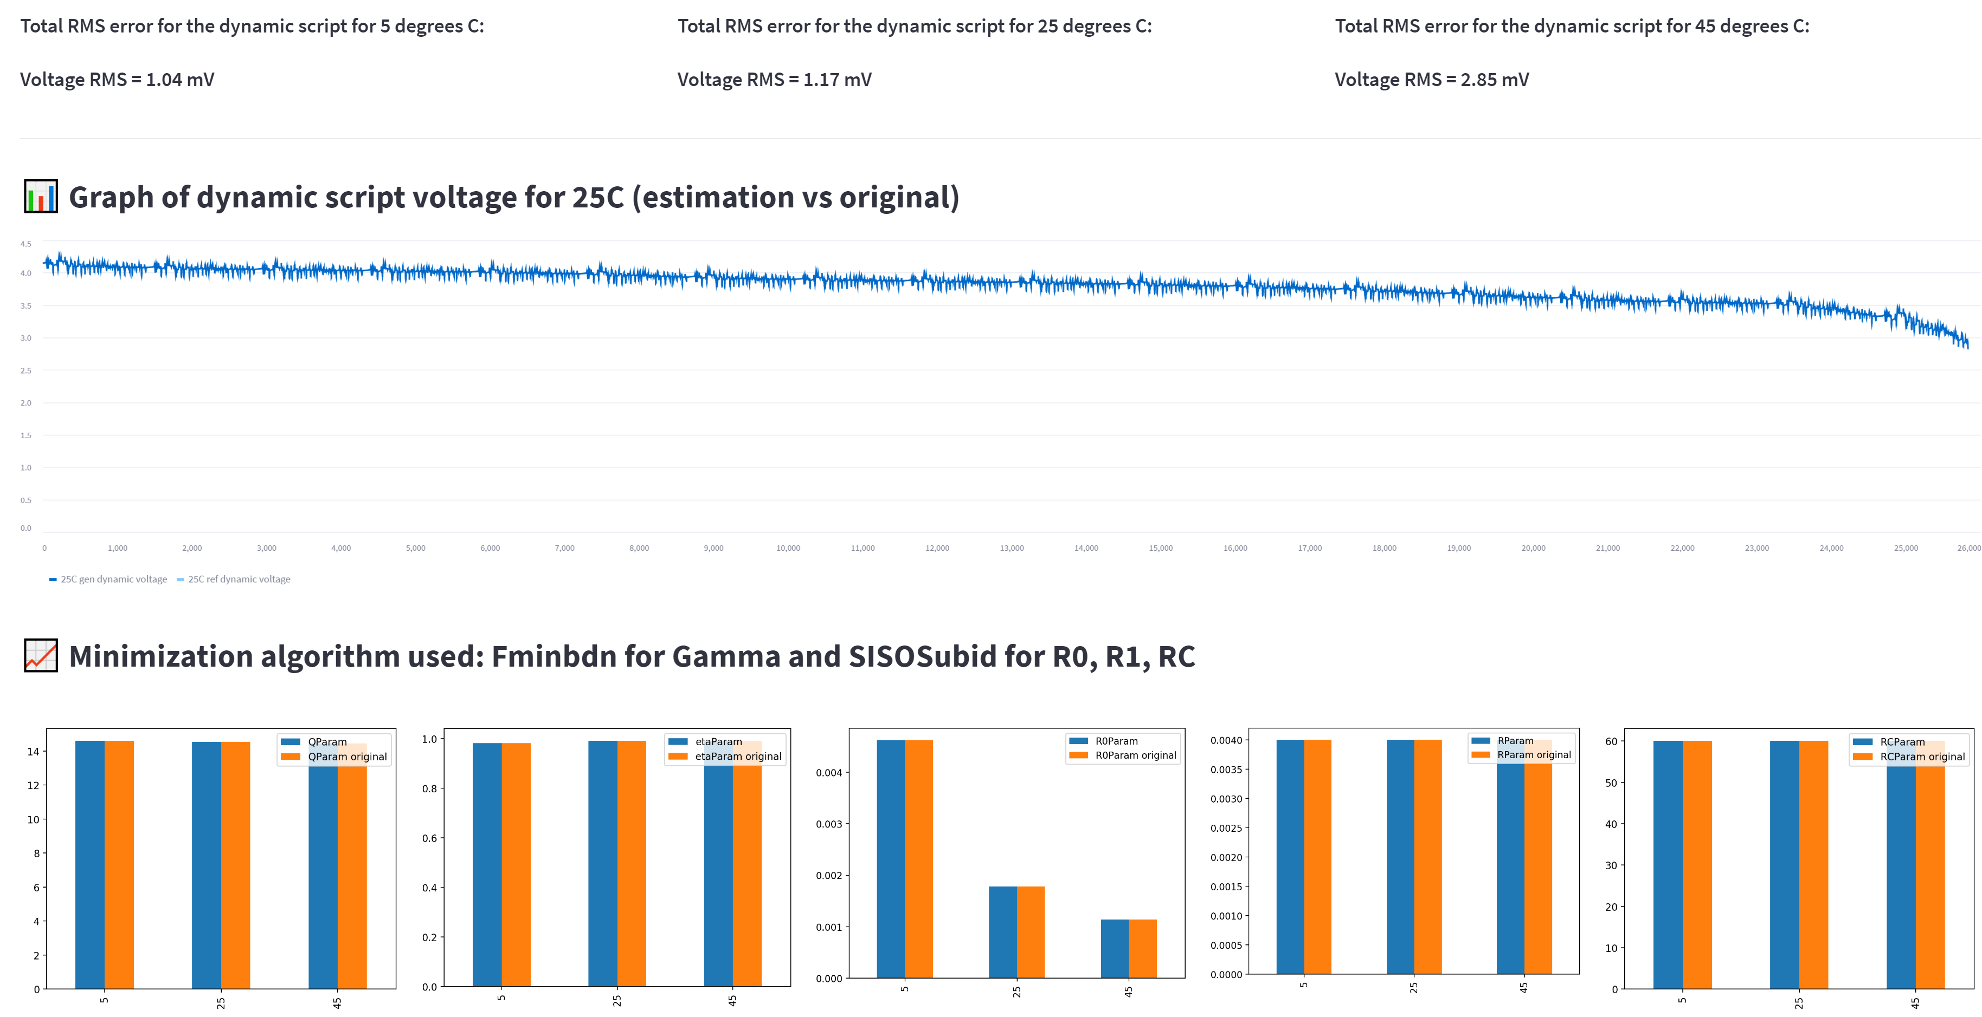
No hysteresis (Good initial guess):

Slide 6
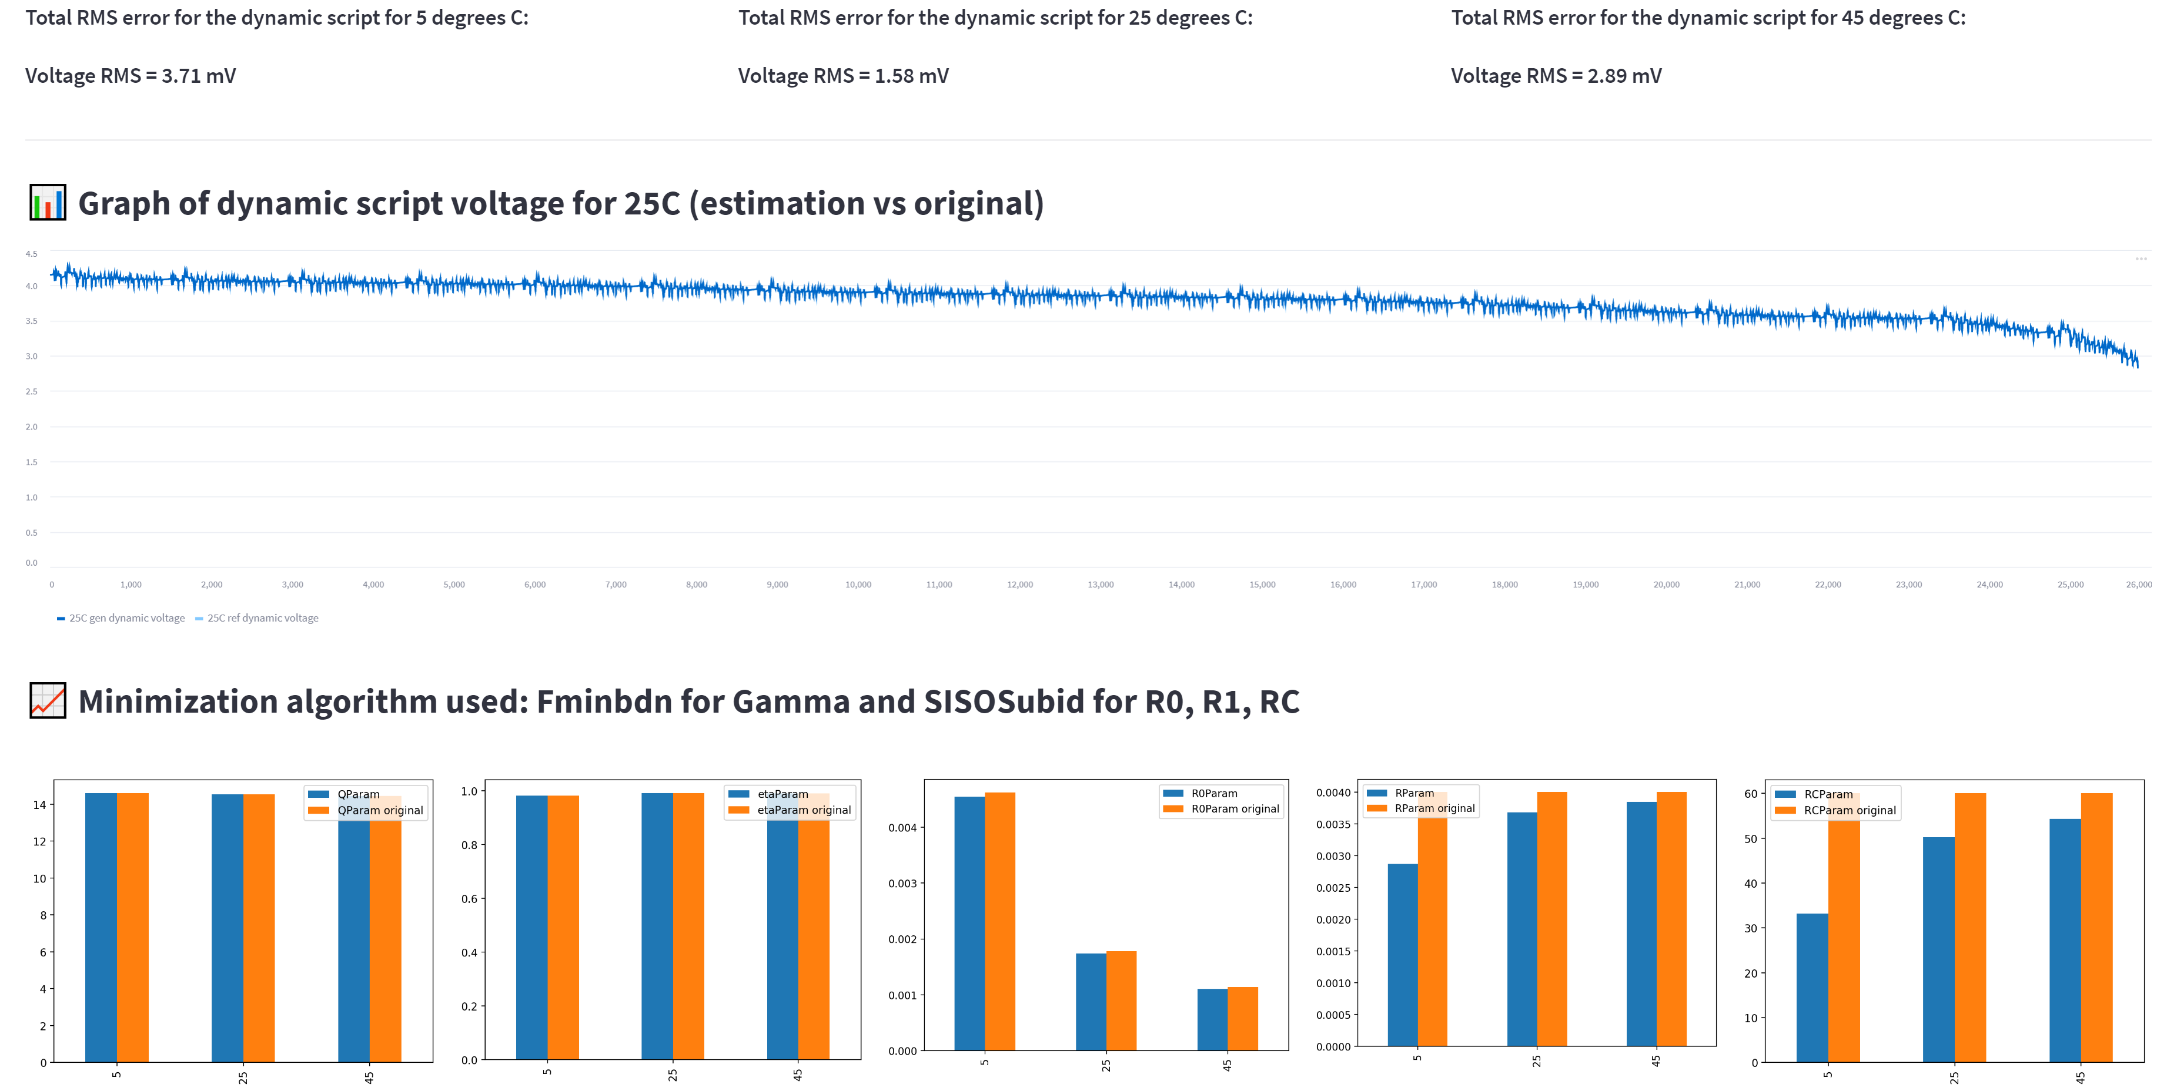
No hysteresis (random initial guess):

Slide 7
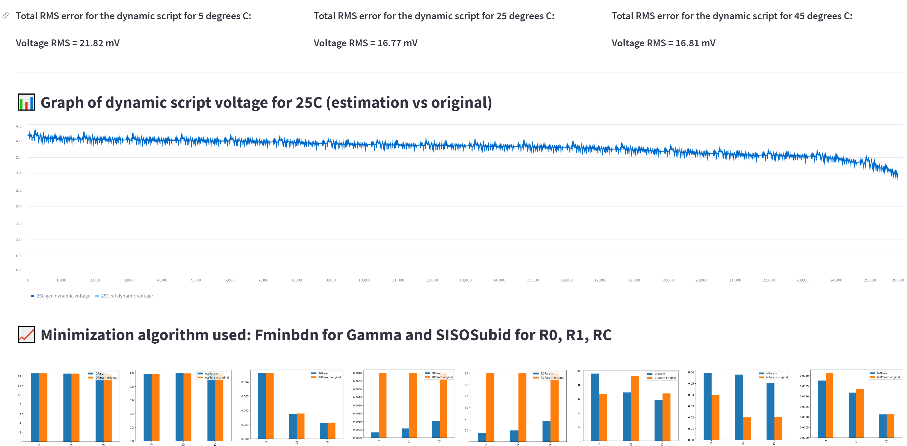
With hysteresis (random initial guess):

Slide 8
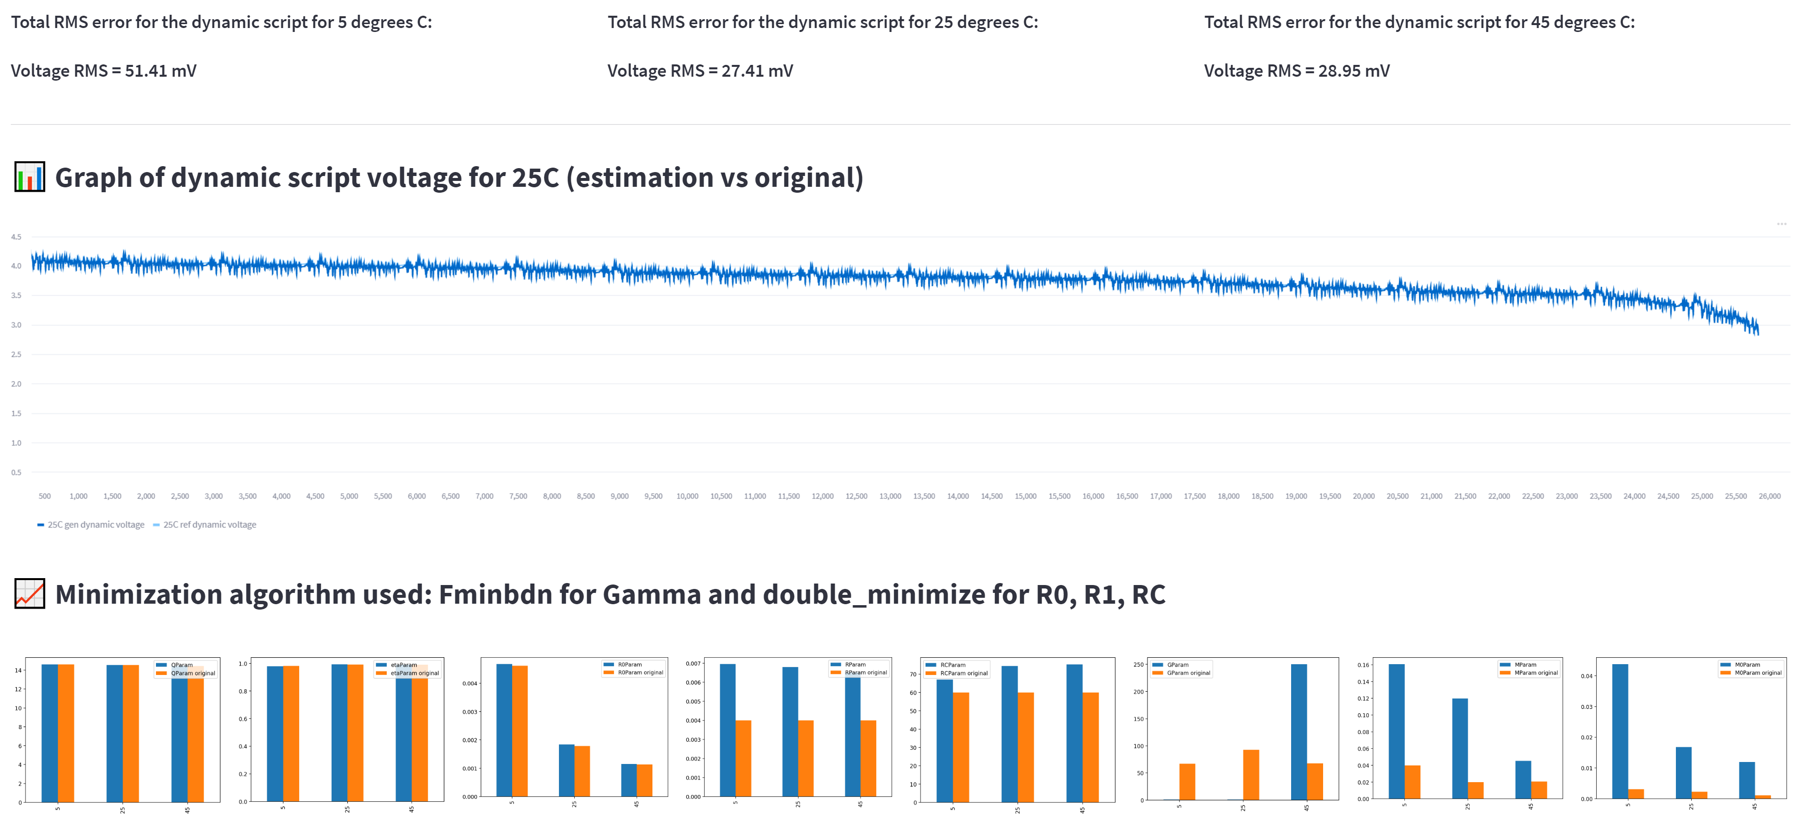
With hysteresis (double minimize, triple minimize and differential evolution):

Slide 9
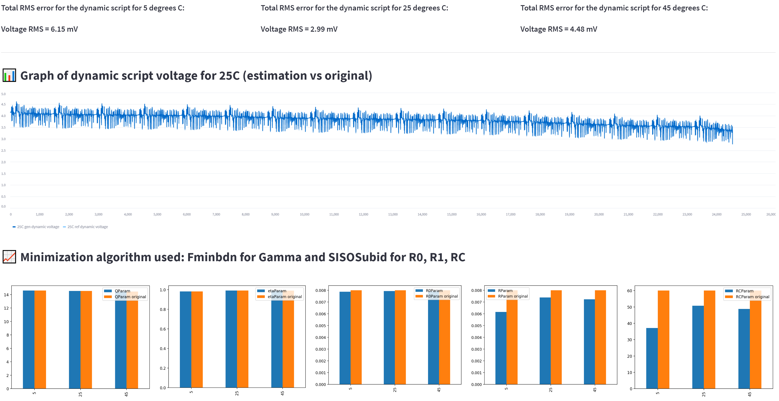
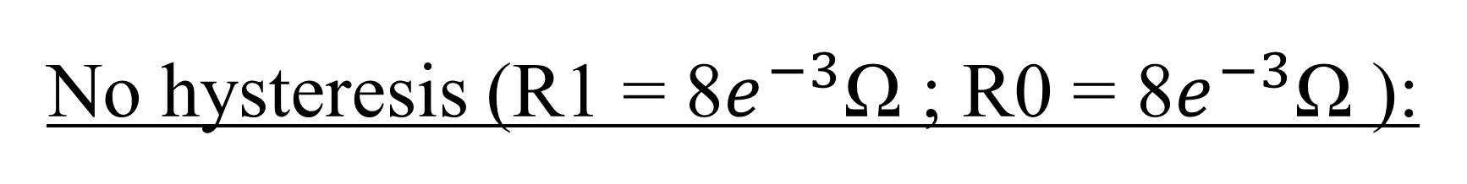
No hysteresis (R1 = 8$e^{−3}$Ω ; R0 = 8$e^{−3}$Ω ):

Slide 10
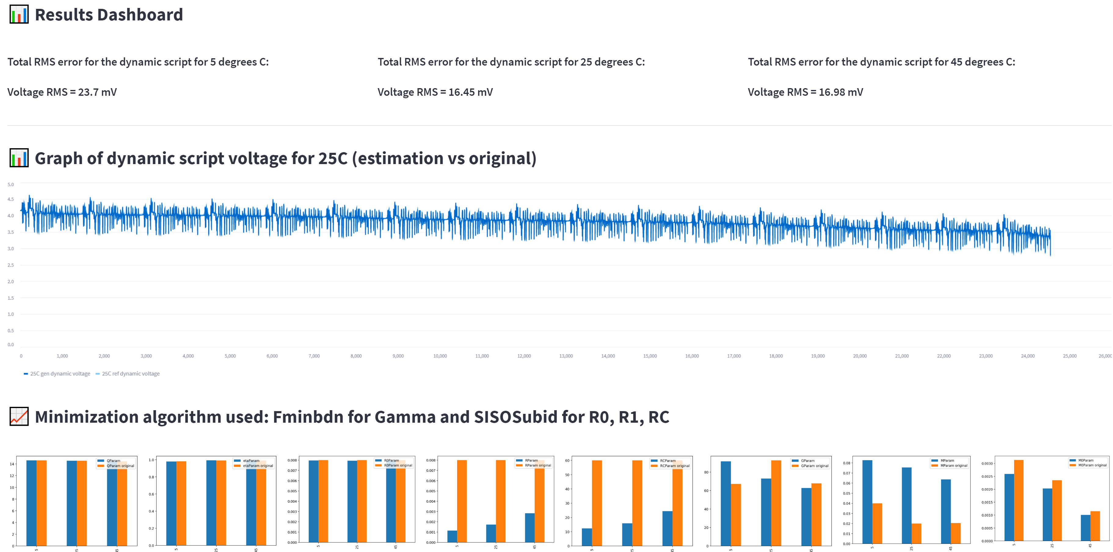
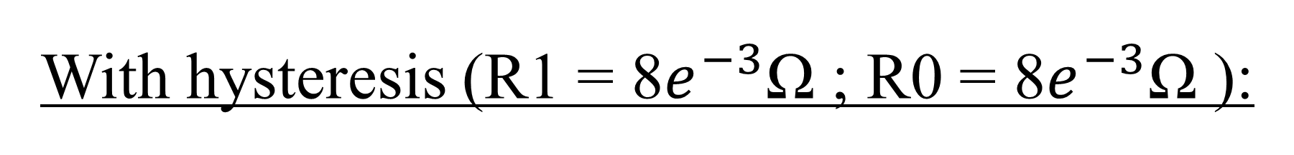
With hysteresis (R1 = 8$e^{−3}$Ω ; R0 = 8$e^{−3}$Ω ):

Slide 11
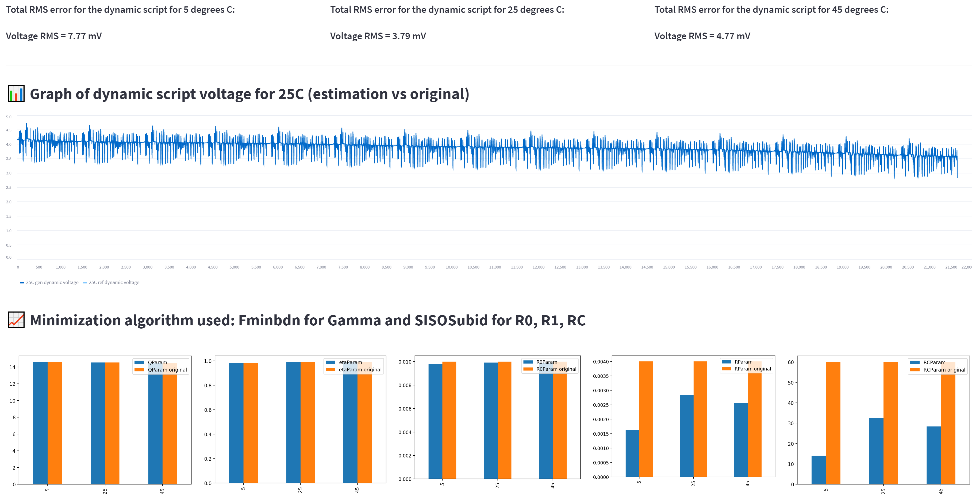
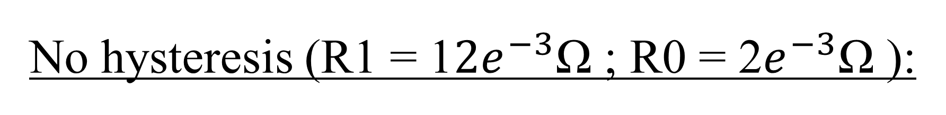
No hysteresis (R1 = 1$2e^{−3}$Ω ; R0 = 2$e^{−3}$Ω ):

Slide 12
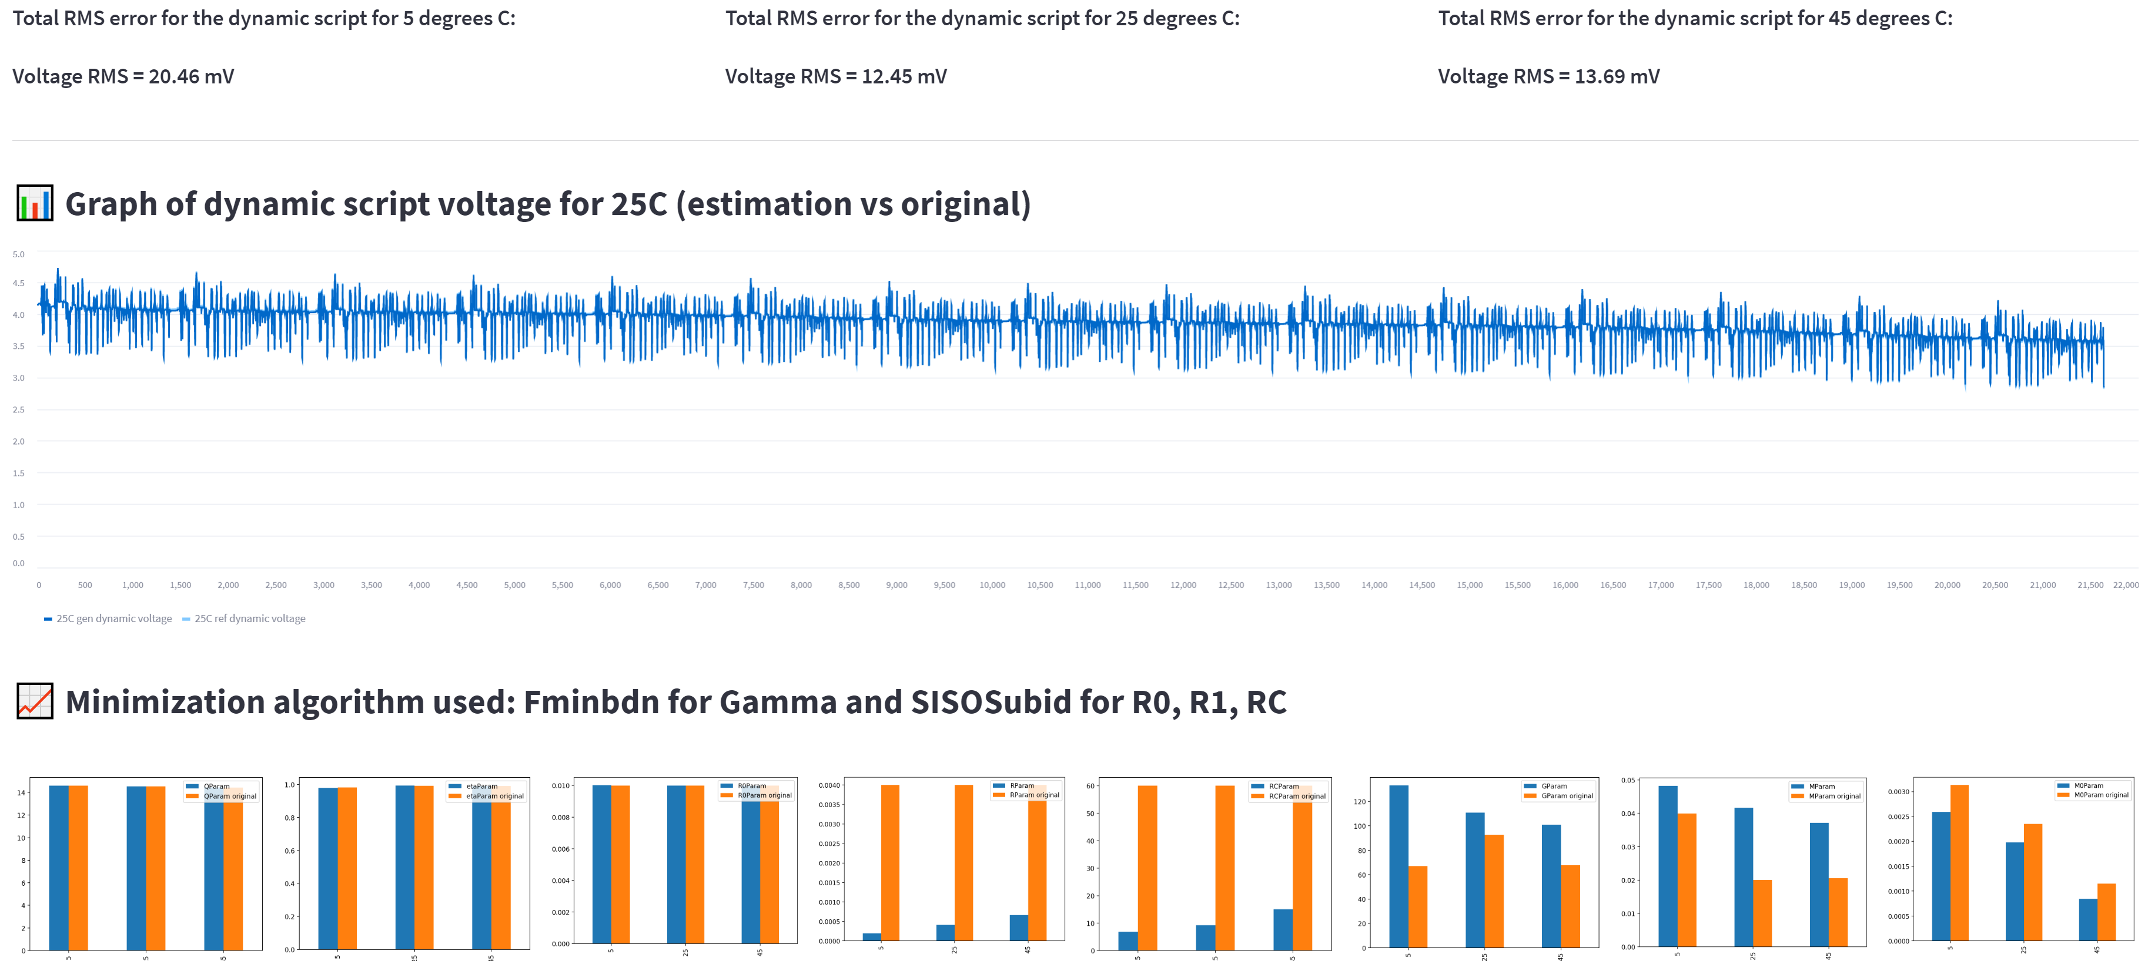
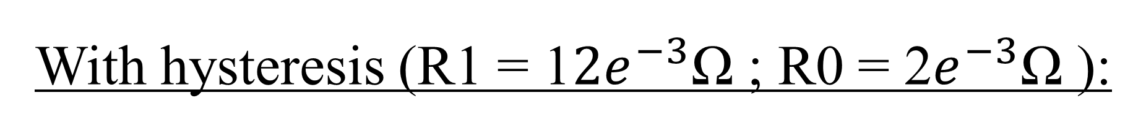
With hysteresis (R1 = 1$2e^{−3}$Ω ; R0 = 2$e^{−3}$Ω ):

Slide 13
Next steps:
If higher fidelity is needed there are two options:
increase in the number of RC poles will always reduce RMS error
Introducing better initial guess
Real laboratory test need to be compiled for proper marketing potential (steps 5, 6 and 7)
With new parametrized battery cells, experiment on some BMS hardware and prove the fidelity of the virtual system with the real system

